Slide 1
Synthetic Differential Privacy Data Generation for Revealing Bias Modelling Risks
By: Matthew Wilchek & Yingjie wang

Slide 2

Agenda
Introduction
Related Work
Proposed Synthetic Data Generation Method
Validation of Synthetic Data Inference
Experimental Modelling Results
Conclusion
Discussion

Slide 3
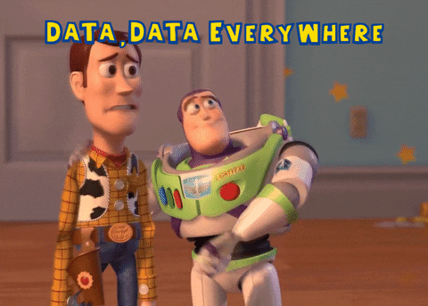
introduction
Synthetic data continues to be desirable across research and industry
Ability to create as much data needed
Ability to label/annotate the data during the generation
Avoids the collection of data that may be too difficult to obtain
Synthetic Personally Identifiable Information (PII) can still be tricky to generate
Often not accurate or a true replica of actual PII data
Common machine-learning techniques, like GANs, are vulnerable to privacy leakage
We propose a novel solution for synthetic PII that avoids these common challenges, but discuss risks how synthetic PII may impact machine-learning applications

Slide 4
Related work
Synthetic PII Development
Yale, A., Dash, S., Dutta, R., Guyon, I., Pavao, A., & Bennett, K. (2019, April). Privacy preserving synthetic health data. In ESANN 2019-European Symposium on Artificial Neural Networks, Computational Intelligence and Machine Learning. | Developed a Wasserstein Generative Adversarial Network (WGAN) Trained from the dataset MIMIC-III (Medical Information Mart for Intensive Care) Also known as “HealthGAN” Evaluated the GAN if a record could leak actual PII Always found some level of privacy leakage
Reiter, J., & Drechsler, J. (2010). Releasing Multiply-imputed Synthetic Data Generated In Two Stages To Protect Confidentiality. In Statistica Sinica, 20(1), 405-421. | Propose a two-stage synthesis algorithm that imputes random values over the actual data May continually impute repeatedly for certain values to drive down variance and lower chances of privacy leakage Reduces risks in missing synthetic data
Ethical Concerns in Modelling with PII
Bellovin, S. M., Dutta, P. K., & Reitinger, N. (2019). Privacy and synthetic datasets. In Stan. Tech. L. Rev., 22, 1. | Proposes the concept that “Differential Privacy” maximizes the accuracy of queries from a dataset while limiting or minimizing the potential for privacy leakage A core piece is the introduction of randomness behind imputation while not impacting the overall dataset's valid inferences Differential privacy synthetic data can assure that individuals will not be identified through deniability

Slide 5



Synthetic data generation – the core
Based on the related work, to create synthetic differential privacy PII an algorithm MUST handle entropy carefully to maintain a dataset’s veracity and value
Python libraries that could specialize in this implementation include “Faker” or “Mimesis”
Using “Mimesis”: out of the generation of 100,000 named records, 98% were unique
Using “Faker”: out of the generation of 100,000 named records, only 71% were unique
What library to use depends on the context of the synthetic data desired for inference
Additional inference can be imputed later, such as distributions of certain records based on real data

Slide 6
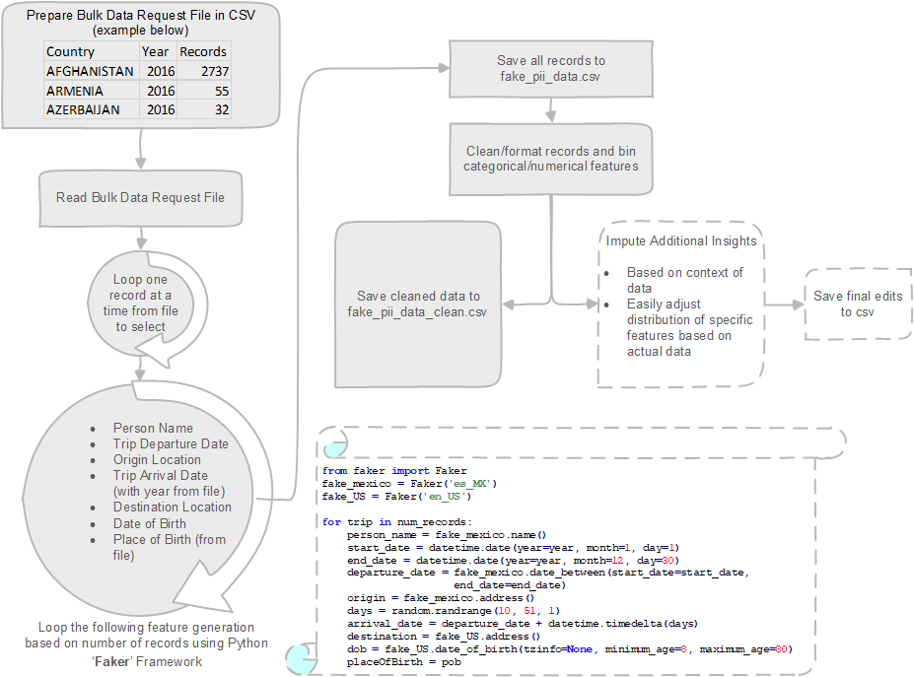
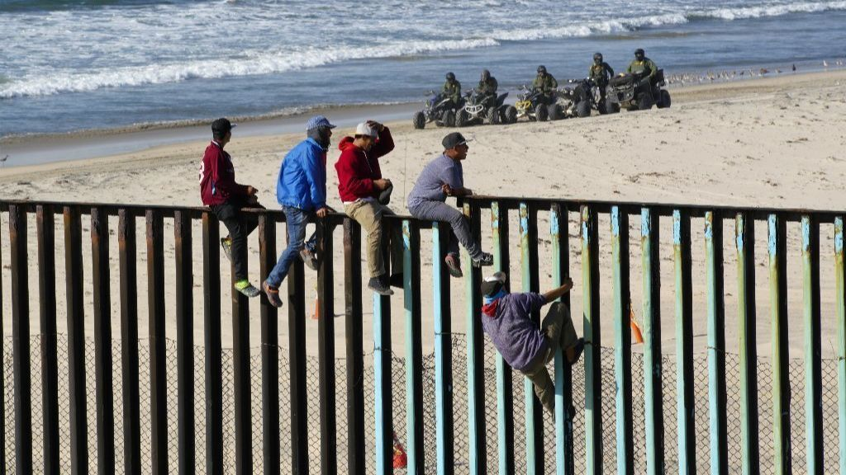
Synthetic data generation – context & process
Developing a synthetic travel dataset used to predict the PII features of an individual that may travel between Mexico and the United States
Requires several PII-related features such as
Demographics (ethnicity/place of birth)
Age
Gender
Dates of travel
Origin location
Destination location
All of which are features “Faker” can create including SSNs, emails, or phone numbers
Duplicate individuals travelling on different dates would be good to represent repeated offenders
Notes:
Migration movements have been a hot topic in the news for the United States. They are likely an issue targeted by migrant and policy research institutions or even law enforcement agencies. Often many socioeconomic factors contribute to migrant travel; however, if PII is collected on these individuals, it could likely strengthen a predictive application.
Our aim was to generate a real-world travel dataset used to predict the PII features of an individual that may travel between Mexico and the United States. This predictive problem would likely require several PII-related features such as demographics, age, gender, dates of travel, and origin/destination locations. Additional features could also be added depending on the context of this problem by industry type.

Slide 7
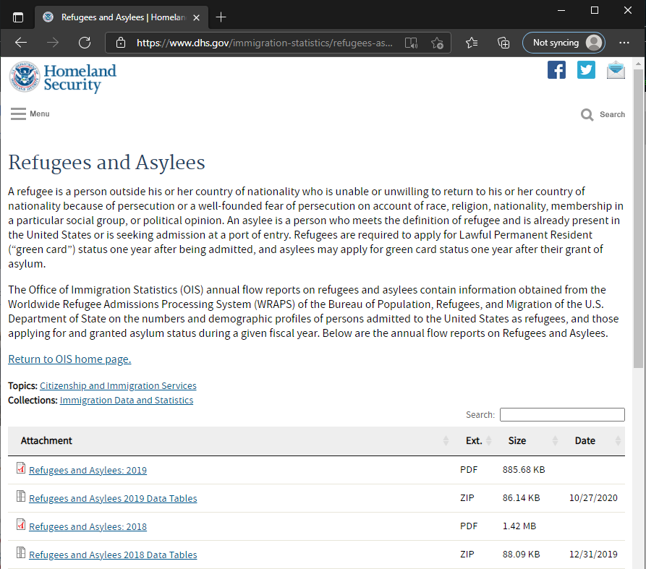
Synthetic data generation – imputing inference
As an optional step after data generation, additional inference can be imputed
Based on the data context, find a real dataset that is like the one made
Get the real distributions of certain features
Adjust the synthetic data distributions to that of the real distributions for those features
Example: We took the number of refugees in 2019, 2018, 2017 and 2016 that travelled to the United States by Place of Birth and drove our synthetic data generation based off that real distribution
https://www.dhs.gov/immigration-statistics/refugees-asylees

Slide 8
Validation of Synthetic Data Inference - features
Feature | Type | Distribution Method
origin_state_province | Categorical | Random
destination_state_province | Categorical | Random
AgeBin | Categorical | Real Distribution
TripLengthBin | Categorical | Random
place_of_birth | Categorical | Real Distribution
gender | Categorical | Real Distribution
season | Categorical | Random
trip_length | Numeric | Random
age_at_arrival | Numeric | Real Distribution
From the 170,241 synthetically generated records, a further data engineering has been done to conceptualized two numeric features.
Age and Trip Length are binned into categorical features:
Age: 0 to 9, 10 to 19, 20 to 39, 40 to 60, and 60 years and over
Trip Length: 0-10, 10-15, 15-20, 20-25, 25-30, 30-35, 35-40, 40-45, 45-50
Here are all the features used in validation through statistical inference and machine learning.

Slide 9
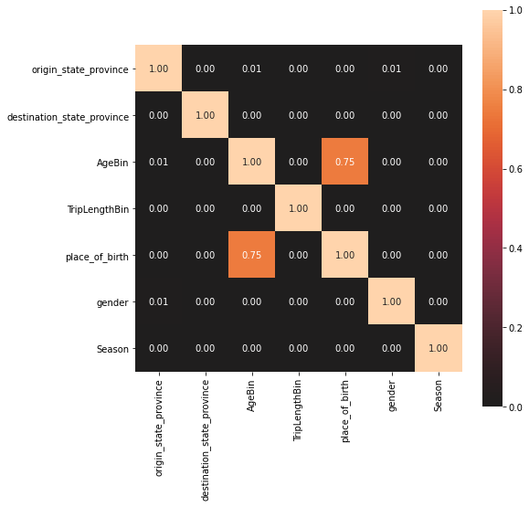
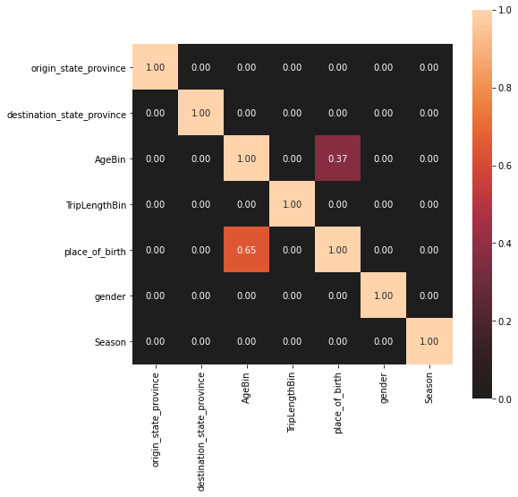
Validation of Synthetic Data Inference - correlation
To calculate the correlation/strength-of-association of features, we select Cramer's V and Theil's U for nominal data with no intrinsic order.
As a result, there is a significant association between birthplace and age group from two correlation tests.
In Cramer's V, the strength of association is 0.75, indicating a strong association between two features.
In Theil's U, the value of 0.65 suggests that knowledge of birthplace reduces error in predicting age group by 65%. And it reduces by 37% another way around.
From the data generation perspective, the association can lead to biased interpretation on these two independent features. In the migrant travel case, no information shows that people of a particular age group are more likely from one birthplace.

Slide 10
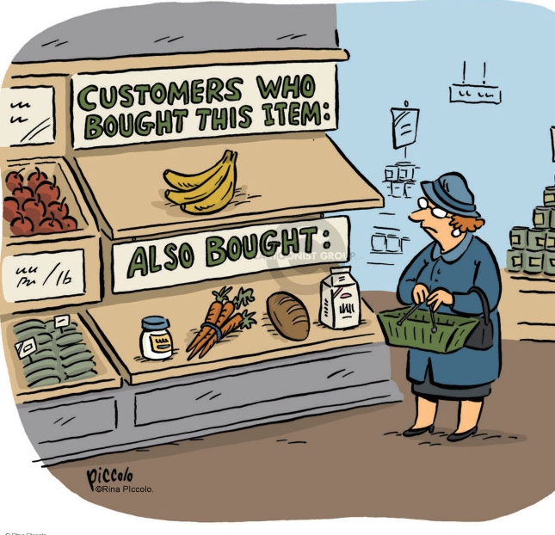

Experimental Modelling - Procedures
Association rule learning is a rule-based machine learning method for discovering interesting relations between features.
It identifies frequent if-then associations called association rules.
The objective of our modeling is to see whether we can get any association between travel origins, destinations, and PII fields.
Procedures:
Implement one-hot encoding on all the categorical features.
Apply the Apriori algorithm for extracting frequent item sets for further analysis .
Select rules based on support, confidence, and lift.

Slide 11
Experimental Modelling Results
antecedents | consequents | support | confidence | lift
place_of_birth _AFGHANISTAN | AgeBin_0-9 | 0.0219 | 1 | 3.7700
place_of_birth _BHUTAN | AgeBin_0-9 | 0.0615 | 1 | 3.7700
The result shows a strong association between place of birth and age bin. Also, some origins/destinations likely to have a traveler by a specific gender.
The reason behind the misleading result is that we do not have a balanced distribution of categories in features.
The unsupervised model, such as association rule mining, can make the biased judgment more specific since the model is only based on the data distribution. Even with entirely random objectives (origin/destination), a model still remains a risk to reveal biased insights.
antecedents | consequents | support | confidence | lift
origin_state_province _GRO | gender _male | 0.0193 | 0.6222 | 1.0544
destination_state_province _MD | gender _male | 0.0118 | 0.6151 | 1.0349
origin_state_province _BCS | gender _female | 0.0130 | 0.4174 | 1.0479
origin_state_province _CHIS | gender _female | 0.0127 | 0.4104 | 1.0303

Slide 12
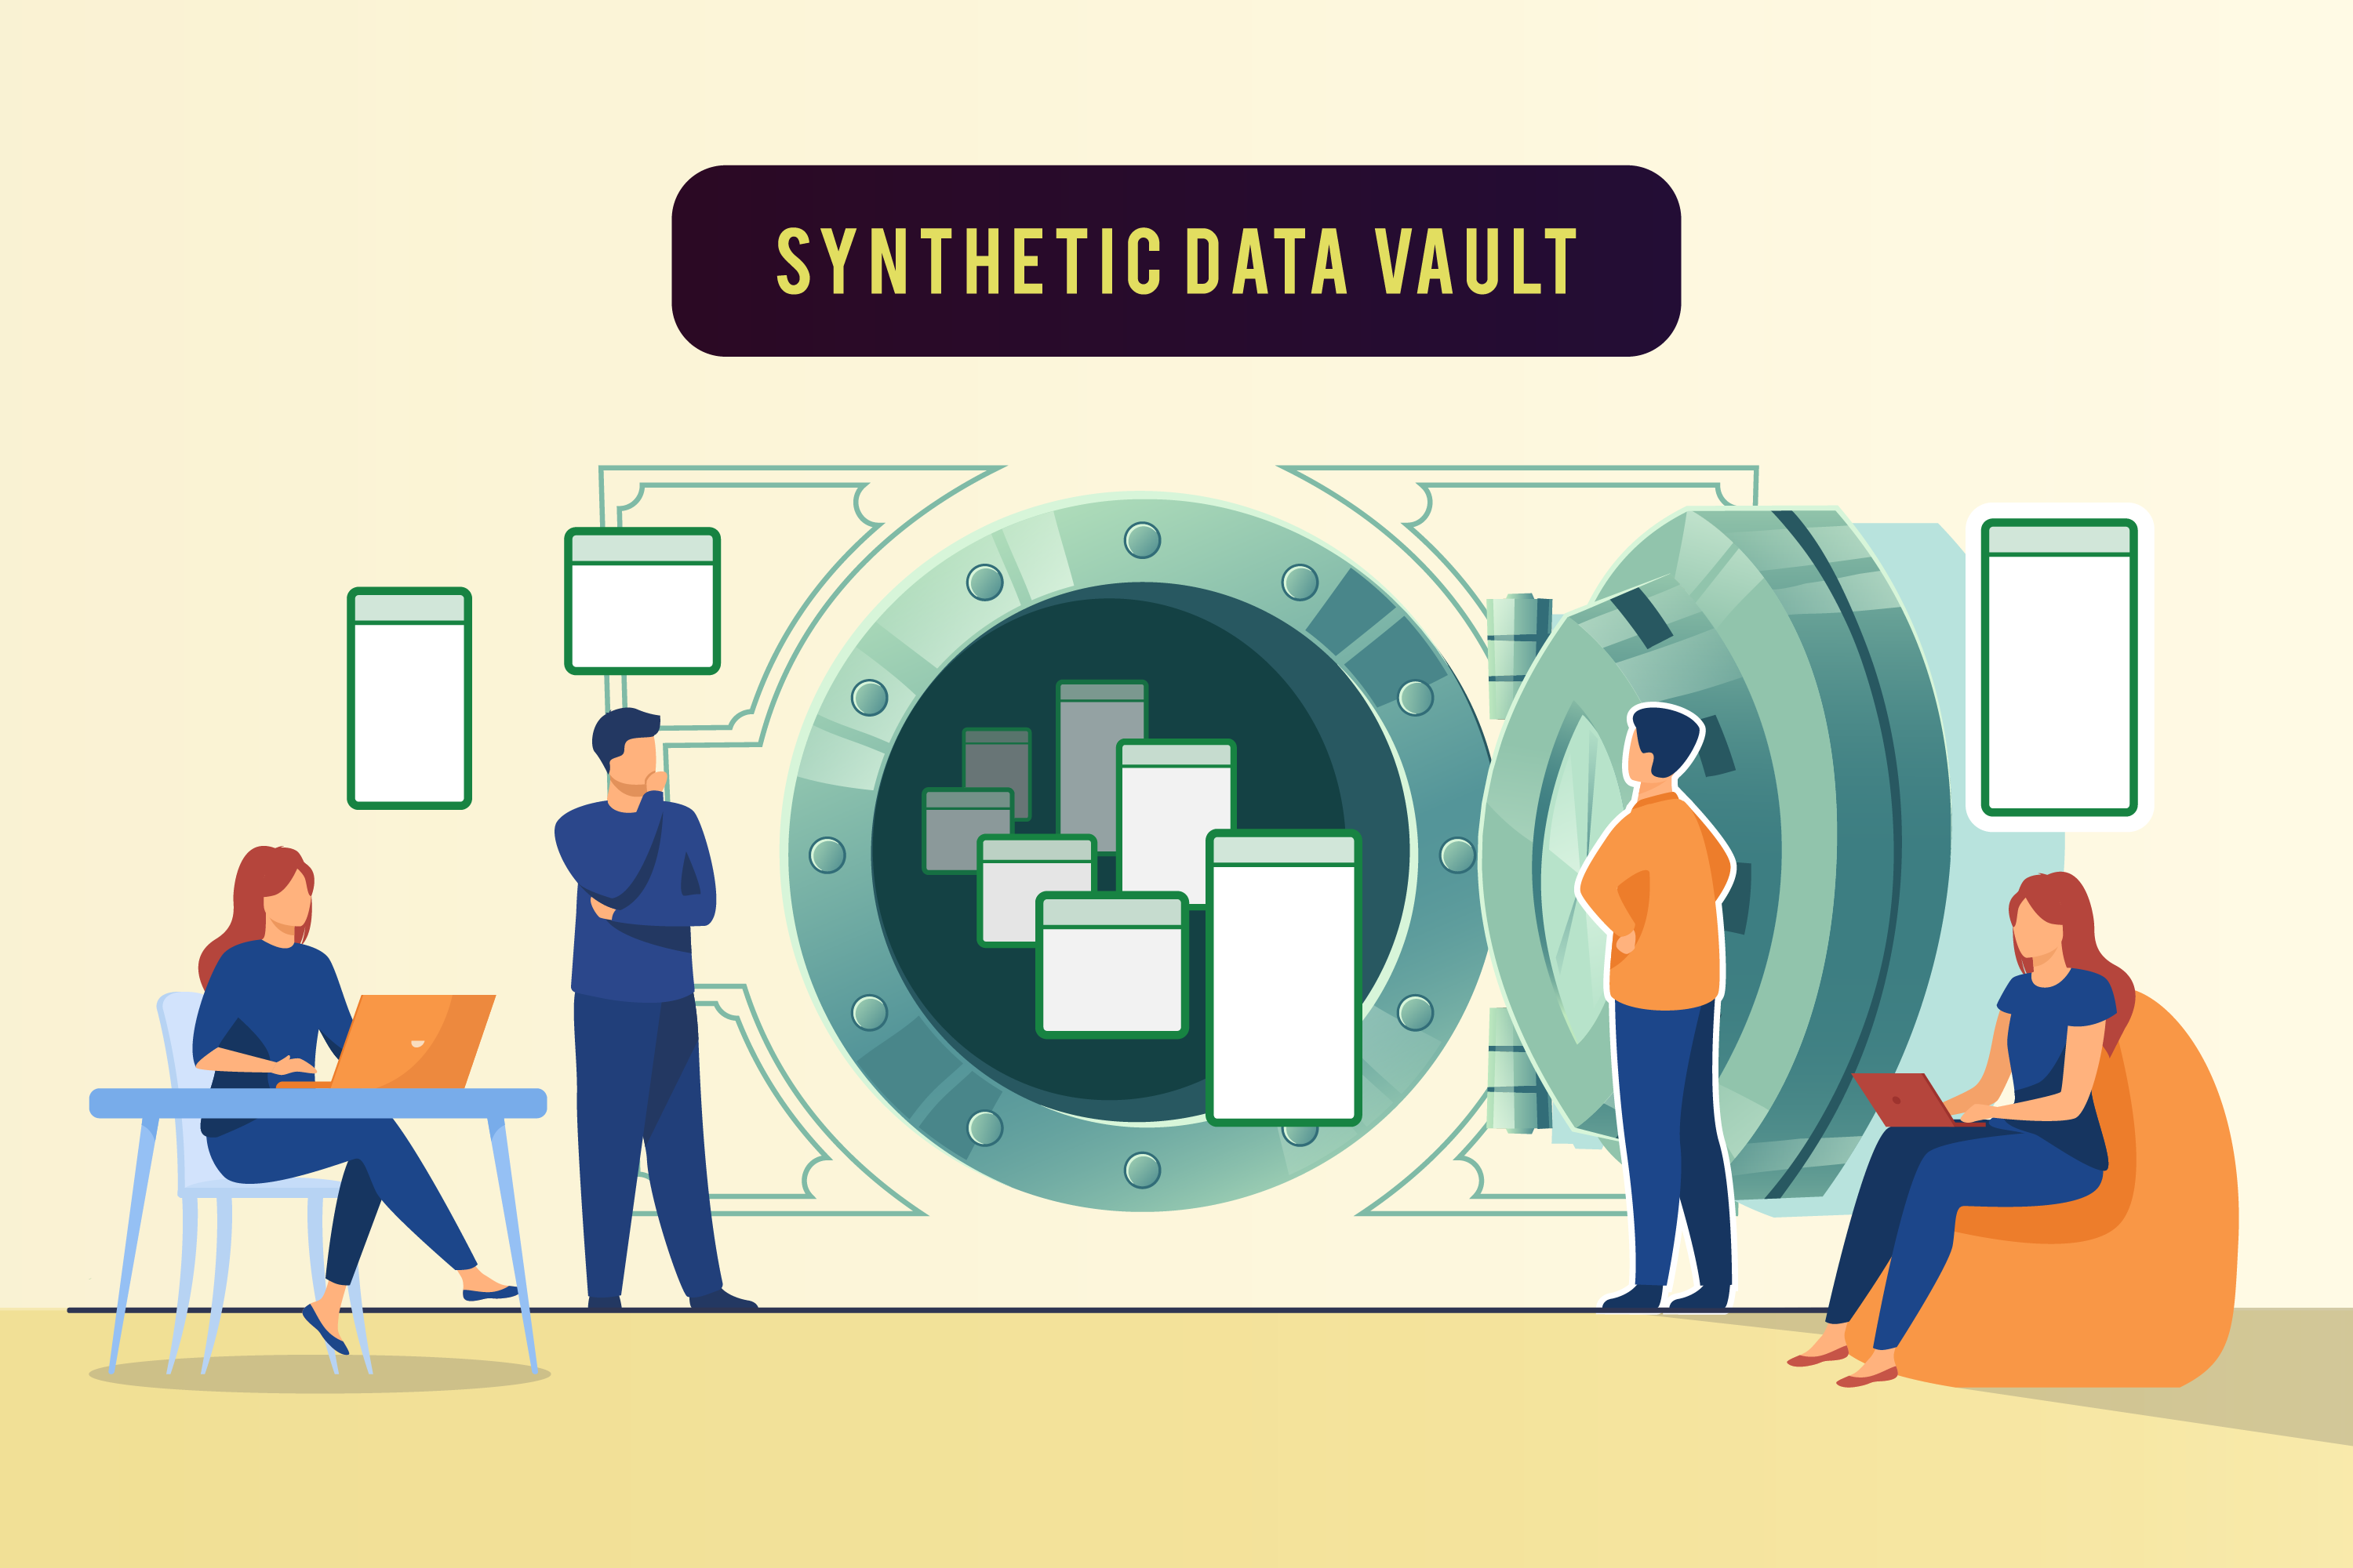
Conclusion
Creating fully synthetic, differential privacy PII data is possible using existing programmatic frameworks like "Faker." However, additional post-processing must be completed to ensure that the randomized features are similar to distributions of real data in order to act as a true replica.
This process can easily be customizable based on the context of categorical data needed. It may prove helpful for added data in training machine-learning models or practicing analytics in an academic environment.
In addition, we can conclude that creating unbiased associations or predictions when using PII data for models may be difficult to avoid. And it could bring potential risks when performing the exploratory data analysis and predictive modelling on the synthetic PII data.
The insights that we learned from synthetic data and adjusted distributions of real data might lead to some coincidental findings that could mimic genuine insights of real data. The process we took of adding additional insights is the generalizable concept that can be applied to a multitude of topics for academia or industry.

Slide 13
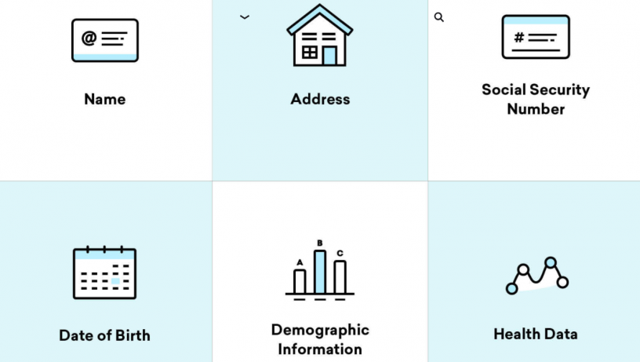

discussion
The future of using PII for predictive applications may continue to be behind closed doors
Will the government be an enabler or inhibitor for this data practice?
More discussion is needed between legal researchers and data scientists to standardize what level of PII can be acceptable to use for predictive applications
Next Step: perform additional research in evaluating the differential privacy data generation process

Slide 14
Additional references
Bellovin, S. M., Dutta, P. K., & Reitinger, N. (2019). Privacy and synthetic datasets. In Stan. Tech. L. Rev., 22, 1. https://law.stanford.edu/wp-content/uploads/2019/01/Bellovin_20190129.pdf
Bhuiyan, Johana. (2021, March 24). This is what happens when ICE asks Google for your user information. Yahoo News. https://news.yahoo.com/happens-ice-asks-google-user-120018014.html
Montes, Juan and Alicia A. Caldwell. (2021, March 24). Men Looking for Work Drive Surge in Illegal Crossings at the U.S. Border. The Wall Street Journal. https://www.wsj.com/articles/men-looking-for-work-drive-migrant-surge-at-the-u-s-border-11616624482?reflink=desktopwebshare_permalink
Plummer, Libby. (2017, August 22). This is how Netflix's top-secret recommendation system works. In Wired. https://www.wired.co.uk/article/how-do-netflixs-algorithms-work-machine-learning-helps-to-predict-what-viewers-will-like
Raghunathan, T. E., Reiter, J. P. and Rubin, D. B. (2003). Multiple imputation for statistical disclosure limitation. J. Off. Statist. 19, 1-16. http://www2.stat.duke.edu/~jerry/Papers/jos03.pdf
Hong, Jason I., Jennifer D. Ng, Scott Lederer, and James A. Landay. (2004). Privacy risk models for designing privacy-sensitive ubiquitous computing systems. In Proceedings of the 5th conference on Designing interactive systems: processes, practices, methods, and techniques (DIS '04).
Reiter, J., & Drechsler, J. (2010). Releasing Multiply-imputed Synthetic Data Generated In Two Stages To Protect Confidentiality. In Statistica Sinica, 20(1), 405-421. http://www.jstor.org/stable/24308998
Xiang, Xiayu., Duan, Shaoming., Pan, Hezhong., Han, Peiyi., Cao, Jiahao., and Liu, Chuanyi. (2020). From One-hot Encoding to Privacy-preserving Synthetic Electronic Health Records Embedding. In Proceedings of the 2020 International Conference on Cyberspace Innovation of Advanced Technologies (CIAT 2020). DOI:https://doi.org/10.1145/3444370.3444605
Yale, Andrew., Saloni Dash, Ritik Dutta, Isabelle Guyon, Adrien Pavao, and Kristin P. Bennett. (2019). Assessing privacy and quality of synthetic health data. In Proceedings of the Conference on Artificial Intelligence for Data Discovery and Reuse (AIDR '19). DOI:https://doi.org/10.1145/3359115.3359124
Immigration Customs Enforcement (ICE). (2020). Refugees and Asylees 2019 Data Tables. Immigration Statistics. https://www.dhs.gov/immigration-statistics/refugees-asylees

Slide 15
acknowledgements
We thank Dr. Jacqueline Serigos (George Mason University) and Dr. Amir Jafari (George Washington University) for reviewing our paper and providing helpful feedback

Slide 16


Questions? All code and data is available here: https://github.com/mwilchek/Differential-Privacy-Synthetic-PII

